Slide 1
BOUNDARY VALUE PROBLEM AND EIGEN VALUE
by : ROSHNI SHRESTHA

Slide 2
Boundary Value Problems
A BVP is a system of ordinary differential equations with solution and derivative values specified at more than one point
Most commonly, the solution and derivatives are specified at just two points (the boundaries) defining a two-point boundary value problem
In solving initial value problemms, we move in steps from the give initial value of x to the point where the solution is required

Slide 3
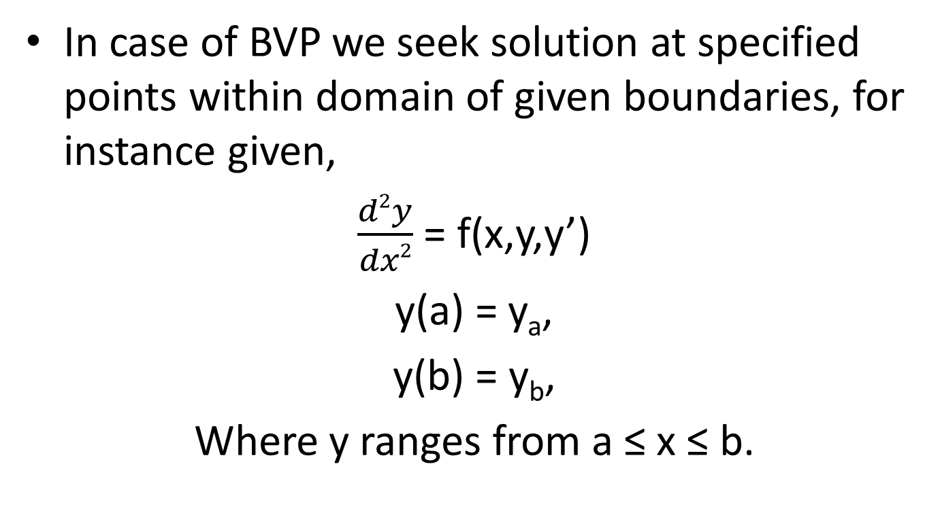
In case of BVP we seek solution at specified points within domain of given boundaries, for instance given,
$\frac{d2y}{dx2}$ = f(x,y,y’)
y(a) = y_{a},
y(b) = y_{b},
Where y ranges from a ≤ x ≤ b.

Slide 4
Boundary Value Problem types
Shooting Method
Finite Difference Method

Slide 5
Shooting Method
It resembles an artillery (shooting ) problem.
Algorithm of shooting method
Convert the problem into an initial value problem,
Initialize the variables including two guesses using either one step or a multistep methods
Interpolate from these results to find an improved value of the slopes obtained
Repeat the process until a specified accuracy in the final function value is obtained

Slide 6
Finite Difference Method
Here the derivatives are replaced by their finite difference equivalents, thus converting the different equation into the system of algebric expressions.
Algorithm finite difference method
Divide the given interval into n subintervals
At each point of x, obtain difference equation using a suitable difference formula. This will result in (n-1) equation with (n-1) unknowns , y₁,y₂,….., y_{n-1}
Solve for y_{i}, i= 1,2,3,…,n-1 using any of the standard elimination methods.

Slide 7
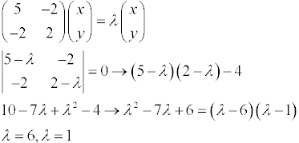
Eigen Value Problems
Some BVP, such as study of vibrating systems, structure analysis, electric circuit system analysis, reduce to a system equations of the form
Ax = λx,
is called eigen value problem.
5x-2y= λx
2y-2x= λy

Slide 8
Application of Eigen Value Problem
To study principal axes of the rotational motion of rigid bodies,
stability analysis,
vibration analysis,
atomic orbitals,
facial recognition, and
matrix diagonalization.

